Slide 1

















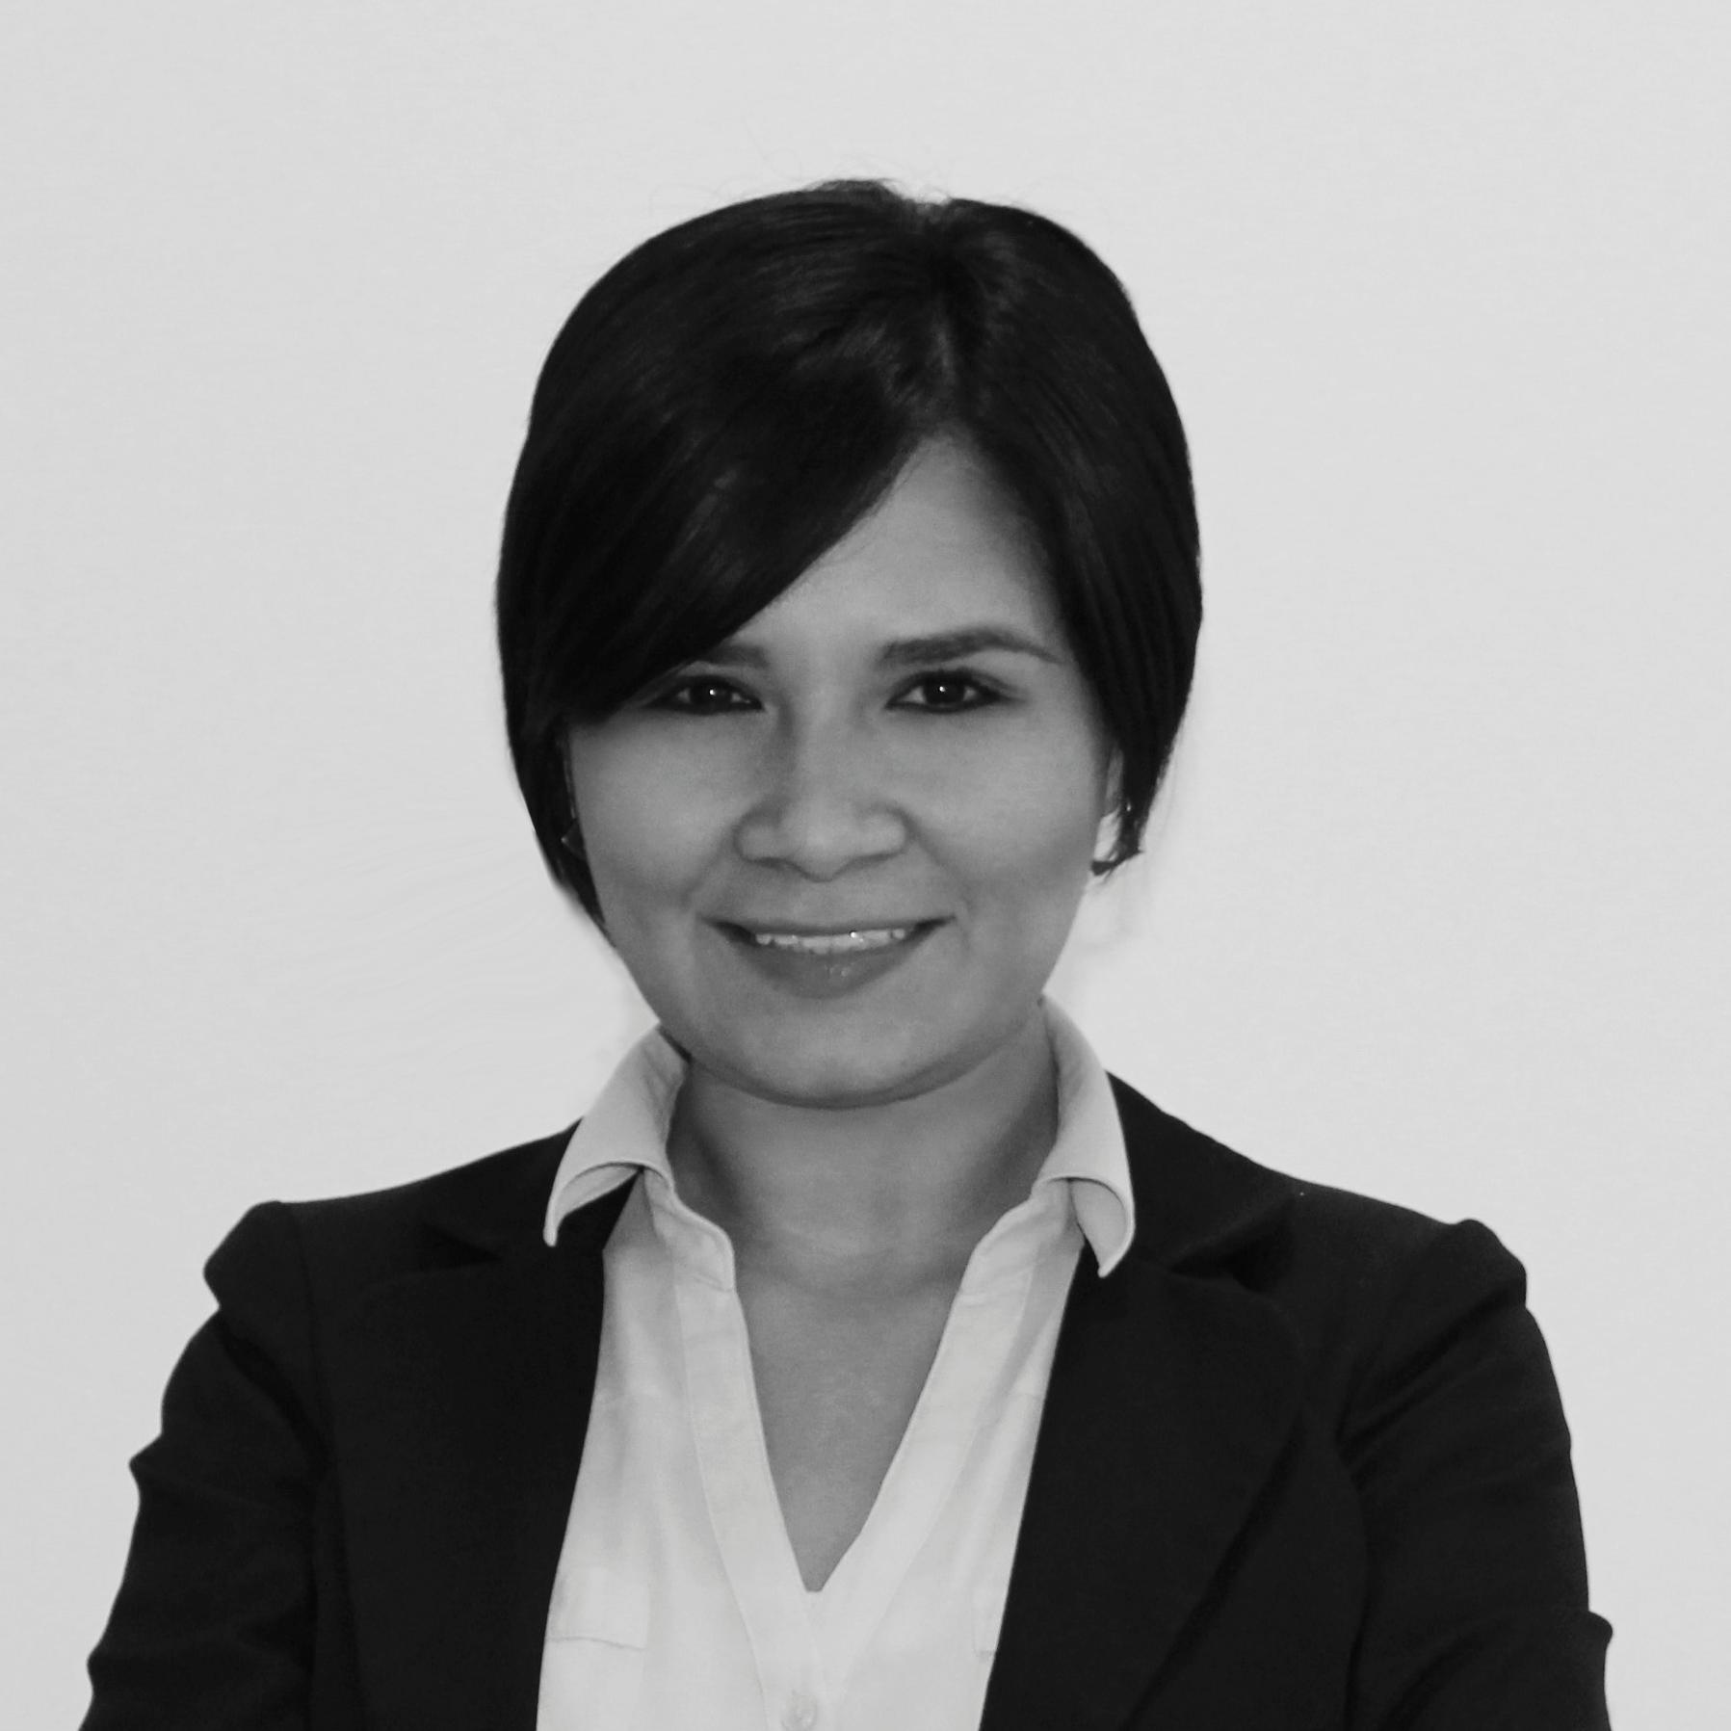







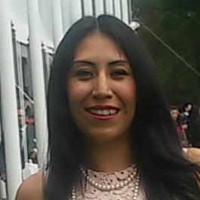





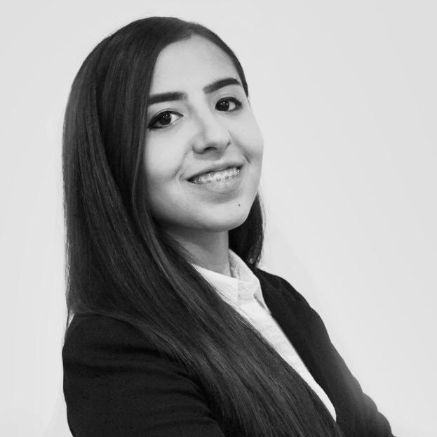




















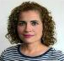














GSC NA Procurement – Transformation Organization
Rocio Schnell
Director Transformation,
Nashville, TN
Todd Diersing
Program Manager,
Seneca, SC
Rosa Petrova
Business Process Manager,
El Paso, TX
Business Unit Partners
Idea Generation & Evolution
Strategic Projects & Program Management
Strategic Projects & Program Management
Tools & Processes Mgt. Resources Coordination
Karthik Machiraju
Retail, Erlanger, KTz
Marlene Garza
PS Manager, MTY MX
Pipeline Generation and PES
Diego Garza
Sr. Manager, MTY MEX
Leader PM
Jan Heinrich UDE
Sr. Manager, MTY MEX
Leader PM
Juan Martin Rosas
Sr. Prj Mgr, MTY, MEX
Lei Zackschewski
Partner Projects, Peru, IN
Andres Chapa
PS, MTY, MEX
Idea Evolution (Ecobuilding & PP)
Nilda Ramos
PM, MTY MEX
SBO P1
Madeleine Gutierrez
PM, MTY MEX
QVE, CoS, SBO K3
Fernando Rodriguez
Sr. Prj Mgr, TXA, MEX
Reb, CoS, QVE
Armando Romero
Prj Mgr, MTY, MEX
PMP certified
Julio Olivares
IT Analyst, MTY, MEX
IT Coordination / Web Apps
Fabiola Salas
Project Mgmt Intern, MTY,
Samples Tracking
Alejandra Romero
Industry & EcoBuildings,
MTY, MEX
Vanessa Lucio
PS MTY, MEX
Idea Evolution (Retail & Projects)
Juan Bacilio Garza
PM, MTY MEX
QVE, CoS, SBO D2-M2
Angel Nunez
PM, MTY MEX
SBO P1 D2-M2
Paola Gomez
Prj Mgr, TXA, MEX
QVE, Reb, Risk Mitigation, CoS
Karla Alonzo
Prj Mgr, El Paso, TX
PMP - CoS, QVE, SBO K3
Luis Perez
IT Analyst, MTY, MEX
Web Apps Development
Betty Oliver
ITD & Energy, Nashville, TN
Alma Dulce Gomez
PS MTY, MEX
Idea Evolution (PP and Energy)
Osvaldo Balboa
PM, MTY MEX
QVE, CoS, SBO G´s
Alexis Quezada
PM, MTY MEX
SBO K3
Manuel Iubeni Guerra
Prj Manager, MTY MEX
QVE, CoS, SBO K2
Mario Gutierrez
Prj Mgr, MTY, MEX
CoS, QVE
Karla Garcia
IT Intern, MTY, MEX
Web Apps Development
Adriana Geniz
PS MTY, MEX Idea Evolution
(Industry & Ecobuildings)
Ricardo Ruiz
PM, MTY MEX
QVE, CoS, SBO K1 and K2
Rosa Valdez Parks
PM, MO
SBO
Carlos Galvan
Prj Mgr, MTY, MEX
CoS, QVE
Jean Alvarado
IT Intern, MTY, MEX
Web Apps Development
Alex Casillas
PS MTY, MEX
Idea Evolution (ITD and Industry)
Open position
Raul Raygoza
MTY, MEX
Idea Evolution (Energy and Retail)
Manuel Solis
PIIT CoS Engr Mgr, MTY, MEX
Prj Mgr, CoS & SBO
Valdemar Berlanga
PIIT QVE Engr Mgr, MTY MEX
QVE/CoS/Design/Reverse Eng/
Materials Eng
Ricardo Gongora
Supplier Quality Manager
NAM Strategic Projects
Elena Manriquez
Elec-Mech Eng. PIIT MTY, MEX
QVE & Reverse Engineering
Edgar Arredondo
Prod Design Eng. PIIT MTY, MEX
CoS & Core Team Member
Marco Rodriguez
Elec-Mech Engr, PIIT MTY, MEX
CoS & SBO
Karla Sauceda
Elec- Mech Engr, PIIT MTY MEX P lastics/QVE -COS
Jorge Chacon
Senior Designer, PIIT MTY MEX
Design 2D 3D/Rev Eng/QVE
Karen Puente
Designer, PIIT MTY MEX
Rev Eng / Design 2D 3D
Lucy Casas
Supplier Quality Engr MTY MEX NAM Strategic Projects
Armando Fernandez
Supplier Quality Engr MTY MEX
NAM Strategic Projects
Karla Juarez
Supplier Quality Engr MTY MEX
NAM Strategic Projects
Abraham de Leon
Mechanical Eng. PIIT MTY,MEX
CoS-Lessons Learned, SBO K1/K2
Manuel Peinado
Elec-Mech Sr Eng.PIIT MTY, MEX CoS & SBO K5/K6
Gina Hernandez
Sr. Electronics Design Engr
CoS & QVE
Mayra Munoz
Elec- Mech Engr, PIIT MTY MEX
Materials/QVE-COS
Jose Lopez
Mechanical Drafter, PIIT MTY ME
Design 2D 3D / Geomagic Dx
Hector Corpus
Mechanical Drafter, PIIT MTY MEX Design 2D 3D / Geomagic ctrl
Priscila Navarrete
Supplier Quality Engr MTY ME
NAM Strategic Projects
Raul de la Rosa
Supplier Quality Engr MTY MEX
NAM Strategic Projects
Aldo Cardenas
Supplier Quality Engr MTY MEX
NAM Strategic Projects
Alejandra Garza
Elec-Mech Eng. PIIT MTY, MEX
CoS & SBO P1
Open Position
Barbara Martinez
Elec-Mech Engr, PIIT MTY, MEX
CoS & SBO
Liza Martinez
Elec- Mech Engr, PIIT MTY MEX
QVE-COS
Anahi Contreras
Elec-Mech Engr, PIIT MTY MEX
Design 2D 3D/Geomagic/Labels
Laura Luna
Supplier Quality Engr MTY MEX
NAM Strategic Projects
Nayeli Diaz
Quality Technician MTY MEX
NAM Strategic Projects
Jose Luis Luna
Supplier Quality Engr TLX MEX
NAM Strategic Projects
Fatima Guzman
Supplier Quality Engr MTY MEX
NAM Strategic Projects
Open Position

Slide 2

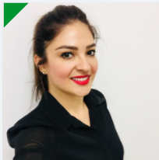
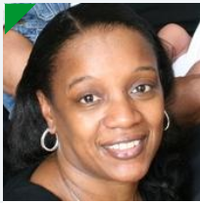
Business Unit Partners
Rocio Schnell
Director Transformation, Clovis,CA
Karthik Machiraju
Retail, Erlanger, KT
Alejandra Romero
Industry & EcoBuildings, MTY, MEX
Lei Zackschewski
Partner Projects, Peru, IN
Betty Oliver
ITD & Energy, Nashville, TN
Notes:
This is an example of a Text Slide. Reference the different layout options in the Slide Master (under the View tab) for different variations. Remember, our new Brand Guidelines call for clean and simple messages and design. Reference the PowerPoint Guidelines on the Brand Book for tips and useful information on creating effective presentations.

Slide 3
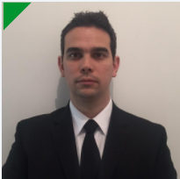
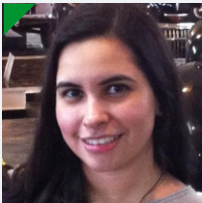


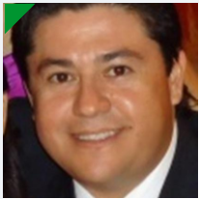



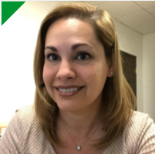
Strategic Projects & Program Management
Diego Garza
Sr. Manager, MTY MEX
Leader PM
Nilda Ramos
Prj Manager, MTY MEX
SBO P1
Ricardo Ruiz
Prj Manager, MTY MEX
QVE, CoS, SBO K1 and K2
Angel Nunez
Prj Mgr, MTY MEX
SBO P1 D2-M2
Juan Bacilio Garza
Prj Manager, MTY MEX
QVE, CoS, SBO D2-M2
Osvaldo Balboa
Prj Mgr, MTY MEX
QVE, CoS, SBO G´s
Alexis Quezada
Prj Mgr, MTY MEX
SBO K3
Madeleine Gutierrez
Prj Manager, MTY ME
QVE, CoS, SBO K3
Open position
Rosa Valdez Parks
Prj Mgr , MO
SBO
Notes:
This is an example of a Text Slide. Reference the different layout options in the Slide Master (under the View tab) for different variations. Remember, our new Brand Guidelines call for clean and simple messages and design. Reference the PowerPoint Guidelines on the Brand Book for tips and useful information on creating effective presentations.

Slide 4
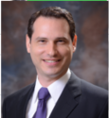

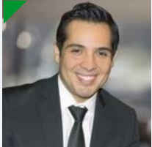

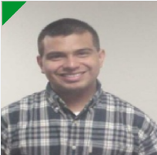

Strategic Projects & Program Management
Jan Heinrich UDE
Sr. Manager, MTY MEX Leader PM
Fernando Rodriguez
Sr. Prj Mgr, TXA, MEX
Reb, CoS, QVE
Armando Romero
Prj Mgr, MTY, MEX
PMP certified
Carlos Galvan
Prj Mgr, MTY, MEX
CoS, QVE
Paola Gomez
Prj Mgr, TXA, MEX
QVE, Reb, Risk Mitigation, CoS
Karla Alonzo
Prj Mgr, El Paso, TX
PMP - CoS, QVE, SBO K3
Mario Gutierrez
Prj Mgr, MTY, MEX
CoS, QVE
Manuel Iubeni Guerra
Prj Manager, MTY MEX
QVE, CoS, SBO K2
Notes:
This is an example of a Text Slide. Reference the different layout options in the Slide Master (under the View tab) for different variations. Remember, our new Brand Guidelines call for clean and simple messages and design. Reference the PowerPoint Guidelines on the Brand Book for tips and useful information on creating effective presentations.

Slide 5
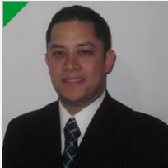
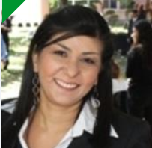
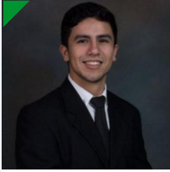
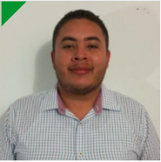
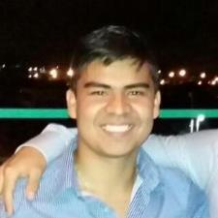
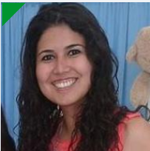

Project Engineers
Manuel Solis
PIIT CoS Engr Mgr, MTY, MEX
Prj Mgr, CoS & SBO
Elena Manriquez
Elec-Mech Eng. PIIT MTY, MEX
QVE & Reverse Engineering
Edgar Arredondo
Prod Design Eng. PIIT MTY, MEX
CoS & Core Team Member
Marco Rodriguez
Elec-Mech Engr, PIIT MTY, MEX
CoS & SBO
Abraham de Leon
Mechanical Eng. PIIT MTY,MEX
CoS-Lessons Learned, SBO K1/K2
Manuel Peinado
Elec-Mech Sr Eng.PIIT MTY, MEX CoS & SBO K5/K6
Gina Hernandez
Sr. Electronics Design Engr.
PIIT MTY, MEX, CoS & QVE
Alejandra Garza
Elec-Mech Eng. PIIT MTY, MEX
CoS & SBO P1
Barbara Martinez
Elec-Mech Engr, PIIT MTY, MEX
CoS & SBO
Open Position
Notes:
This is an example of a Text Slide. Reference the different layout options in the Slide Master (under the View tab) for different variations. Remember, our new Brand Guidelines call for clean and simple messages and design. Reference the PowerPoint Guidelines on the Brand Book for tips and useful information on creating effective presentations.

Slide 6




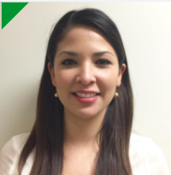



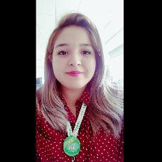
Projects Engineers
Valdemar Berlanga
PIIT QVE Engr Mgr, MTY MEX
QVE/CoS/Design/Reverse Eng/
Materials Eng
Karla Sauceda
Elec- Mech Engr, PIIT MTY MEX
Plastics/QVE -COS
Jorge Chacon
Senior Designer, PIIT MTY MEX
Design 2D 3D/Rev Eng/QVE
Karen Puente
Designer, PIIT MTY MEX
Rev Eng / Design 2D 3D
Mayra Munoz
Elec- Mech Engr, PIIT MTY MEX
Materials/QVE-COS
Jose Lopez
Mechanical Drafter, PIIT MTY MEX
Design 2D 3D / Geomagic Dx
Hector Corpus
Mechanical Drafter, PIIT MTY MEX
Design 2D 3D / Geomagic ctrl
Liza Martinez
Elec- Mech Engr, PIIT MTY MEX
QVE-COS
Anahi Contreras
Elec-Mech Engr, PIIT MTY MEX
Design 2D 3D/Geomagic/Labels
Notes:
This is an example of a Text Slide. Reference the different layout options in the Slide Master (under the View tab) for different variations. Remember, our new Brand Guidelines call for clean and simple messages and design. Reference the PowerPoint Guidelines on the Brand Book for tips and useful information on creating effective presentations.

Slide 7


Idea Generation & Evolution
Marlene Garza
Prj Specialist Manager, MTY MX
Pipeline Generation and PES Auditor
Andres Chapa
Prj Specialist MTY, MEX
Idea Evolution (Ecobuilding & PP)
Alma Dulce Gomez
Prj Specialist MTY, MEX Idea Evolution (PP and Energy)
Alex Casillas
Prj Specialist MTY, MEX
Idea Evolution (ITD and Industry)
Vanessa Lucio
Prj Specialist MTY, MEX
Idea Evolution (Retail & Projects)
Adriana Geniz
Prj Specialist MTY, MEX
Idea Evolution (Industry & Ecobuildings)
Raul Raygoza
Prj Specialist MTY, MEX
Idea Evolution (Energy and Retail)
Notes:
This is an example of a Text Slide. Reference the different layout options in the Slide Master (under the View tab) for different variations. Remember, our new Brand Guidelines call for clean and simple messages and design. Reference the PowerPoint Guidelines on the Brand Book for tips and useful information on creating effective presentations.

Slide 8

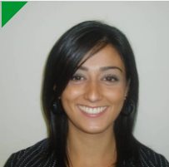

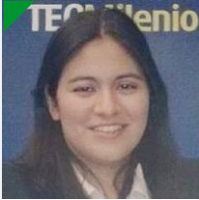





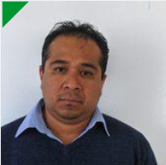
available position
Supplier Quality & Logistics – Strategic Projects SQLD Team
Ricardo Gongora
Supplier Quality Manager
NAM Strategic Projects
Lucy Casas
Supplier Quality Engr MTY MEX NAM Strategic Projects
Armando Fernandez
Supplier Quality Engr MTY MEX NAM Strategic Projects
Karla Juarez
Supplier Quality Engr MTY MEX NAM Strategic Projects
Priscila Navarrete
Supplier Quality Engr MTY MEX NAM Strategic Projects
Raul de la Rosa
Supplier Quality Engr MTY MEX NAM Strategic Projects
Aldo Cardenas
Supplier Quality Engr MTY MEX NAM Strategic Projects
Laura Luna
Supplier Quality Engr MTY MEX NAM Strategic Projects
Nayeli Diaz
Quality Technician MTY MEX N A NAM Strategic Projects
Jose Luis Luna
Supplier Quality Engr TLX MEX NAM Strategic Projects
Fatima Guzman
Supplier Quality Engr MTY MEX NAM Strategic Projects
Open Position
Notes:
This is an example of a Text Slide. Reference the different layout options in the Slide Master (under the View tab) for different variations. Remember, our new Brand Guidelines call for clean and simple messages and design. Reference the PowerPoint Guidelines on the Brand Book for tips and useful information on creating effective presentations.

Slide 9

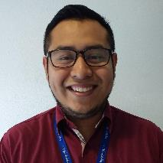

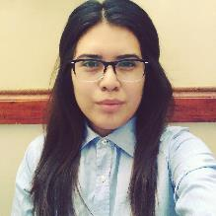
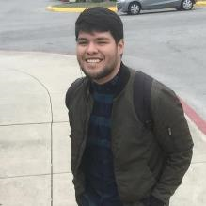
Tools Process Mgt, Resource Coordination
Juan Martin Rosas
Sr. Prj Mgr, MTY, MEX
Julio Olivares
IT Analyst, MTY, MEX
IT Coordination / Web Apps Dev
Luis Perez
IT Analyst, MTY, MEX
Web Apps Development
Fabiola Salas
Project Mgmt Intern, MTY, MEX
Samples Tracking
Karla Garcia
IT Intern, MTY, MEX
Web Apps Development
Jean Alvarado
IT Intern, MTY, MEX
Web Apps Development

